Slide 1
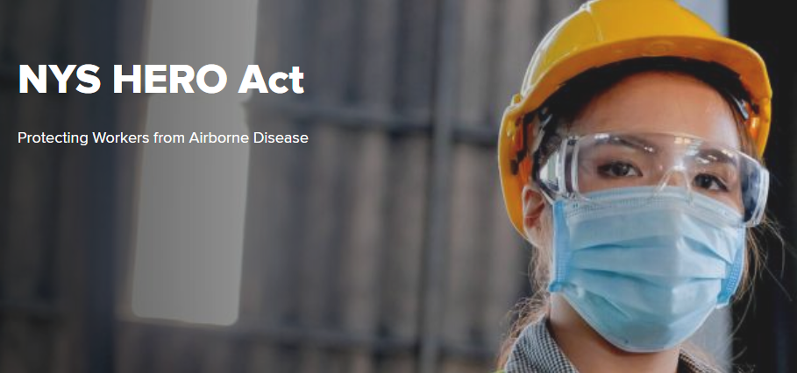
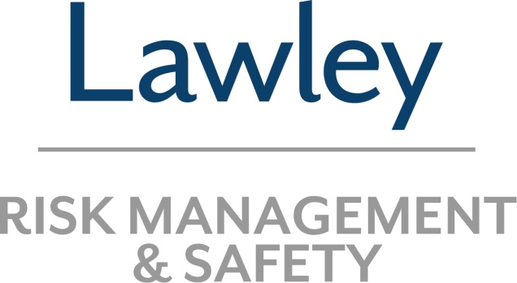
New York State Health and Essential Rights Act | Information & Overview
Brian Greeson
Senior Loss Control Consultant

Slide 2
Topics
HERO Act overview
Employer responsibilities and timelines
Components of the required Airborne Infectious Disease Exposure Prevention Plan
Implementation of your Airborne Infectious Disease Exposure Prevention Plan
Employee training and communication requirements
Safety Committee requirements
Penalties for non-compliance
2
2021 LAWLEY | NYS HERO ACT
Notes:
3

Slide 3
HERO Act Overview
The amended HERO Act took effect on July 5, 2021.
On July 6, 2021 the NY State Department of Labor (NYSDOL) published the following:
The Airborne Infectious Disease Exposure Prevention Standard
A general model Airborne Infectious Disease Exposure Prevention Plan (AIDPP)
Several industry specific model Airborne Infectious Disease Exposure Prevention Plans (Agriculture, Construction, Delivery, Domestic Work, EMS, Food Service, Manufacturing, Personal Services, Private Ed, Private Transportation, Retail)
3
2021 LAWLEY | NYS HERO ACT
Notes:
3

Slide 4
HERO Act Overview
The HERO Act continues to have two distinct requirements for private employers in the State of NY.
Establish an Airborne Infectious Disease Exposure Prevention Plan by August 5, 2021. This applies to ALL private employers, except those noted in the exceptions.
Safety Committee - By November 1, 2021 the law requires covered employers with at least 10 or more employees to permit employees to establish and administer a joint labor-management workplace safety committee.
4
2021 LAWLEY | NYS HERO ACT
Notes:
3

Slide 5
Exceptions
Public Employers - Employees or independent contractors of the state, any political subdivision of the state, a public authority, or any other governmental agency or instrumentality.
Healthcare (currently) - Any employee within the coverage of a temporary or permanent standard adopted by the Occupational Safety and Health Administration setting forth applicable standards regarding COVID-19 and/or airborne infectious agents and diseases.
5
2021 LAWLEY | NYS HERO ACT
Notes:
3

Slide 6
Exceptions
Seasonal / endemic disease - Any seasonal or endemic infectious agent or disease, such as the seasonal flu, that has not been designated by the Commissioner of Health as a highly contagious communicable disease that presents a serious risk of harm to the public health.
6
2021 LAWLEY | NYS HERO ACT
Notes:
3

Slide 7

Airborne Infectious Disease Exposure Prevention Plan
Each covered employer shall establish a written Airborne Infectious Disease Exposure Prevention Plan designed to eliminate or minimize employee exposure to airborne infectious agents in the event of an outbreak of an airborne infectious disease.
TIME TO PLAN
7
2021 LAWLEY | NYS HERO ACT
Notes:
3

Slide 8
Plan Components
Health Screening - Health screening for the disease shall be performed at the beginning of the workday, in accordance with guidance issued by State DOH or the CDC.
Employers must limit the exposure of other individuals to employees demonstrating any symptoms of an airborne infectious disease.
Follow State DOH and or the CDC protocols regarding testing, isolation and quarantine before allowing employees to return to the worksite and inform employees of the same.
8
2021 LAWLEY | NYS HERO ACT
Notes:
3

Slide 9

Plan Components
Face Coverings - The employer shall select and provide at no cost to employees face coverings deemed appropriate and in accordance with guidance from NY DOH or the CDC
The employer shall require that employees wear appropriate face coverings when physical distancing cannot be maintained and in accordance with applicable guidance from State DOH or the CDC
9
2021 LAWLEY | NYS HERO ACT
Notes:
3

Slide 10
Plan Components
Physical Distancing - Physical distancing shall be used, when possible, to keep employees at least six feet apart from other individuals or as recommended by State DOH or CDC.
Hand Hygiene - The employer shall, to the extent practicable and feasible, provide handwashing facilities with an adequate supply of tepid or warm potable water, soap, and single-use towels or air-drying machines.
When providing handwashing facilities is not practical and feasible, the employer shall provide hand sanitizing facilities and/or supplies.
10
2021 LAWLEY | NYS HERO ACT
Notes:
3

Slide 11
Plan Components
Cleaning and disinfection - The employer shall determine and implement an appropriate plan for cleaning and disinfection that includes the methods of decontamination based upon the location, facility type, type of surface(s) to be cleaned, type of material present, tasks or procedures being performed in the area, and as otherwise directed by State DOH or CDC for the disease outbreak.
Surfaces known or believed to be contaminated with potentially infectious materials shall be cleaned and disinfected immediately or as soon as feasible, unless the area and surfaces can be isolated for a period of time prior to cleaning.
11
2021 LAWLEY | NYS HERO ACT
Notes:
3

Slide 12
Plan Components
Frequently touched surfaces, such as handrails, doorknobs, and elevator buttons, shall be disinfected throughout the workday and/or as recommended by State DOH or CDC.
Shared tools, equipment, and workspaces shall be cleaned and disinfected prior to sharing and/or as recommended by State DOH or CDC.
Common areas, such as bathrooms, dining areas, break rooms, locker rooms, vehicles, and sleeping quarters, shall be cleaned and disinfected at least daily or as recommended by State DOH or CDC.
12
2021 LAWLEY | NYS HERO ACT
Notes:
3

Slide 13
Plan Components
Personal Protective Equipment - In addition to that required or recommended by State DOH or CDC, personal protective equipment that is identified as necessary for the protection of the employee shall fit the employee, and be provided, used, and maintained in a sanitary and reliable condition at the expense of the employer.
The employer shall provide and require employees use the personal protective equipment and other personal protective equipment deemed necessary or recommended by State DOH and provide appropriate training and information to each employee required to use personal protective equipment.
13
2021 LAWLEY | NYS HERO ACT
Notes:
3

Slide 14
Plan Components
Where employee-owned personal protective equipment is used at the worksite, the employer shall be responsible for ensuring that the employee-owned personal protective equipment is adequate and functioning properly.
All personal protective equipment, including employee-owned personal protective equipment used at the worksite, shall be stored, used, and maintained in a sanitary and reliable condition in order to be used at the work site.
14
2021 LAWLEY | NYS HERO ACT
Notes:
3

Slide 15
Alternative Plan
Employers may choose to adopt the applicable model plan provided by the NYSDOL, or create their own plan—which must meet (at a minimum) or exceed the standards laid out in the state-developed plans.
Employers that develop their own plan shall adopt such plan pursuant to an agreement with the collective bargaining representative, if any, or with the meaningful participation of employees where there is no collective bargaining representative, for all aspects of the plan, and such plan shall be tailored and specific to the hazards in the specific industry and worksites of the employer.
15
2021 LAWLEY | NYS HERO ACT
Notes:
3

Slide 16
Communication / Training
Employers have 60 days after the publication of the model plans, or until September 4, 2021, to distribute and communicate the plans to employees.
Employers will be required to conduct a verbal review of employer policies, employee rights under this section and section 218-b of the labor law, and the employer’s exposure prevention plan.
Employers must add the plan to their employee handbook, distribute their adopted plans to newly hired employees at the time of hire and to all employees within 15 days after reopening after a period of closure due to airborne infectious disease.
16
2021 LAWLEY | NYS HERO ACT
Notes:
3

Slide 17

Plan Implementation
While the plan must be prepared by August 5, 2021, the plan only needs to be activated when an airborne infectious disease is designated by the New York State Commissioner of Health as a highly contagious communicable disease that presents a serious risk of harm to the public health.
17
2021 LAWLEY | NYS HERO ACT
Notes:
3

Slide 18
Plan Implementation
While the NYSDOL continues to deal with COVID-19 and a risk still exists, the NYSDOL has clarified that there is no current designation for COVID-19 by the Commissioner and therefore, no New York employer is required to put a plan in effect at this time due to COVID-19. The safety measures or controls contained in the Airborne Infectious Disease Exposure Prevention Plans are not currently required to be activated.
18
2021 LAWLEY | NYS HERO ACT
Notes:
3

Slide 19
Plan Implementation
When a highly contagious communicable disease is designated by the Commissioner of Health as presenting a serious risk of harm to the public health, each employer shall do the following:
Immediately review the worksite’s exposure prevention plan and update the plan, if necessary, to ensure that it incorporates current information, guidance, and mandatory requirements issued by federal, state, or local governments related to the infectious agent of concern.
Finalize and promptly activate the worksite exposure prevention plan. Provide the verbal review as required.
19
2021 LAWLEY | NYS HERO ACT
Notes:
3

Slide 20
Plan Implementation
Provide each employee with a copy of the exposure prevention plan in English or in the language identified as the primary language of such employees.
Post a copy of the exposure prevention plan in a visible and prominent location at the worksite (except when the worksite is a vehicle).
Ensure that a copy of the exposure prevention plan is accessible to employees during all work shifts.
20
2021 LAWLEY | NYS HERO ACT
Notes:
3

Slide 21
Plan Implementation
Assigning enforcement responsibilities in accordance with Labor Law Section 218-b(2)(i) – which means supervision enforces - and ensuring that adequate enforcement of the worksite’s exposure prevention plan takes place.
Monitor and maintain exposure controls.
Regularly checking for updated information and guidance provided by State DOH or CDC concerning the airborne infectious disease and updating the exposure prevention plan so that the plan reflects current State DOH or CDC recommended control measures.
21
2021 LAWLEY | NYS HERO ACT
Notes:
3

Slide 22
Plan Implementation
Designate one or more supervisory employees to enforce compliance with the exposure prevention plan; the standard and any other federal, state, or local guidance related to preventing the spread of the airborne infectious disease as applicable to employees and third parties such as customers, contractors, and members of the public within the workplace.
No individual who is not a supervisory employee shall have responsibility for overseeing compliance with the requirements of the exposure prevention plan.
22
2021 LAWLEY | NYS HERO ACT
Notes:
3

Slide 23

Communication / Training
Note that if a highly contagious communicable disease is designated by the Commissioner of Health as presenting a serious risk of harm to the public health, each employer must conduct a verbal review of employer policies, employee rights under this section and section 218-b (the HERO ACT) of the labor law, and the employer’s exposure prevention plan.
23
2021 LAWLEY | NYS HERO ACT
Notes:
3

Slide 24
Plan Review, Update and Availability
The plan shall be reviewed and updated whenever necessary to reflect new or modified tasks and procedures which affect occupational exposure and to reflect new or modified employee assignments.
Each employer shall make the exposure prevention plan available, upon request, to all employees, employee representatives, collective bargaining representatives, independent contractors, the department of labor, and the department of health.
24
2021 LAWLEY | NYS HERO ACT
Notes:
3

Slide 25
Anti-Retaliation
An anti-retaliation provision is required that will protect workers from retaliation, discrimination, adverse action, or threats for:
Exercising their rights under the law or under the implemented prevention plan.
Reporting violations of the law or applicable prevention plan.
Reporting an airborne infections disease exposure concern.
Seeking assistance or intervention with respect to such concerns.
25
2021 LAWLEY | NYS HERO ACT
Notes:
3

Slide 26
Anti-Retaliation
Also notable is that the law protects workers from adverse action or retaliation for refusing to work where such worker reasonably believes, in good faith, that such work exposes him/her, or other workers to the disease due to the existence of working conditions that are inconsistent with law.
Notification of a violation by an employee may be made verbally or in writing, and without limitation to format including electronic communications.
26
2021 LAWLEY | NYS HERO ACT
Notes:
3

Slide 27
Anti-Retaliation
To the extent that records exist between the employer and employee regarding a potential risk of exposure, without limitation to format including electronic communications, they shall be maintained by the employer for two years after the conclusion of the designation of a high-risk disease from the Commissioner of Health.
* It is suggested that employers create an anti-retaliation policy statement and share that with employees.
27
2021 LAWLEY | NYS HERO ACT
Notes:
3

Slide 28

Definition of a Worksite
The worksites for which employers must adopt plan(s) are now explicitly limited to those “over which an employer has the ability to exercise control.” Worksites do not include telecommuting or telework sites over which the employer lacks the ability to exercise control or vehicles.
Or do they?
28
2021 LAWLEY | NYS HERO ACT
Notes:
3

Slide 29
Links
The link to General model Airborne Infectious Disease Exposure Prevention Plan - https://dol.ny.gov/system/files/documents/2021/07/p765-ny-hero-act-model-airborne-infectious-disease-exposure-prevention-plan.pdf
The link Industry specific model Airborne Infectious Disease Exposure Prevention Plans - https://dol.ny.gov/ny-hero-act
29
2021 LAWLEY | NYS HERO ACT
Notes:
3

Slide 30
Safety Committee
Section 2 of the HERO Act - Safety Committee - By November 1, 2021 the law requires covered employers with at least 10 or more employees to permit employees to establish and administer a joint labor-management workplace safety committee.
An employer need not create a second committee if one that meets the Act’s requirements is already in existence.
A committee’s role shall be limited to reviewing and/or raising occupational health and safety concerns implicated by the Act’s provisions. A committee’s scope does not reach all parts of New York’s Labor Law.
30
2021 LAWLEY | NYS HERO ACT
Notes:
3

Slide 31

Safety Committee
The regularly scheduled quarterly meetings of the committee shall last no longer than two hours. These meetings must occur during work hours.
The training that safety committee members are entitled to attend, without loss of pay, is limited to a duration of no more than four hours.
31
2021 LAWLEY | NYS HERO ACT
Notes:
3

Slide 32
Safety Committee
The law contains specific requirements for any such committee which include:
Employers must permit employees to establish a Safety Committee composed of at least two-thirds non-supervisory employees. The non-supervisory employees are NOT selected by the employer, they are selected by themselves.
The Safety Committee is co-chaired by a representative of the employer and non-supervisory employees.
If a collective bargaining agreement in place, the collective bargaining representative shall be responsible for the selection of employees.
32
2021 LAWLEY | NYS HERO ACT
Notes:
3

Slide 33

Safety Committee
An employer cannot interfere with the Safety Committee members’ performance of their duties.
An employer can have different Safety Committees for geographically different worksites.
33
2021 LAWLEY | NYS HERO ACT
Notes:
3

Slide 34
Safety Committee
Specific Safety Committee actions include 7 items:
Raise health and safety concerns, hazards, complaints and violations to the employer to which the employer must respond.
Review any policy put into place in the workplace required by any provision of this chapter relating to occupational safety and provide feedback to such policy in a manner consistent with any provision of law.
Review the adoption of any policy in response to any health and safety law, ordinance, rule, regulation, executive order, or other related directive.
34
2021 LAWLEY | NYS HERO ACT
Notes:
3

Slide 35
Safety Committee
Participate in any site visit by government health and safety officials.
Review any report filed by the employer related to health and safety.
Attend quarterly meetings during work hours (limited to two hours per meeting).
Employers must allow employees without loss of pay to attend training on the function of the Safety Committee, on an introduction to occupational safety and health and the responsibilities and rights under this law. The paid training will be limited to no more than four hours.
35
2021 LAWLEY | NYS HERO ACT
Notes:
3

Slide 36
Safety Committee
An employer cannot retaliate against an employee who participates in a Safety Committee.
Collective Bargaining Agreements can waive the Safety Committee rule as long as they explicitly reference the HERO Act.
36
2021 LAWLEY | NYS HERO ACT
Notes:
3

Slide 37

Penalties for Non-Compliance
Failure to abide by an adopted prevention plan could result in civil penalties from $100 to $10,000 per day. Subsequent violations carry higher penalties.
37
2021 LAWLEY | NYS HERO ACT
Notes:
3

Slide 38
Private Suits
The law initially created a private right of action for employees to obtain injunctive relief against employers for failing to comply with the Act under certain circumstances. The remedies which employees can recover in a civil action have been limited.
While employees may still seek injunctive relief, costs, and reasonable attorneys’ fees for an employer’s violation of the airborne infectious disease exposure plan that could result in physical harm to the employee, the amendments removed a provision that would have allowed employees to recover liquidated damages of up to $20,000 for such a violation.
38
2021 LAWLEY | NYS HERO ACT
Notes:
3

Slide 39
Private Suits
The approved amendments also require employees to provide their employer with 30 days’ notice and an opportunity to cure the violation before filing a civil action, unless the “employee alleges with particularity that the employer has demonstrated an unwillingness to cure a violation in bad faith.” Employees must file such a civil action within six months of the date the employee had knowledge of the violation.
Employees who file civil actions that are found by the court to be frivolous may be ordered to pay the costs and reasonable attorney’s fees incurred by the employer in the defense of the action.
39
2021 LAWLEY | NYS HERO ACT
Notes:
3

Slide 40

Contact Info
Brian Greeson
Senior Loss Control Consultant | Lawley
bgreeson@lawleyinsurance.com
716.445.8999
361 Delaware Avenue, Buffalo NY 14202
www.lawleyinsurance.com
1.844.4LAWLEY
40
2021 LAWLEY | NYS HERO ACT
Notes:
3

Slide 41
Thank YOU
Questions?

